Slide 1
Wireshark Ciphers introduction
Submission Template

Slide 2
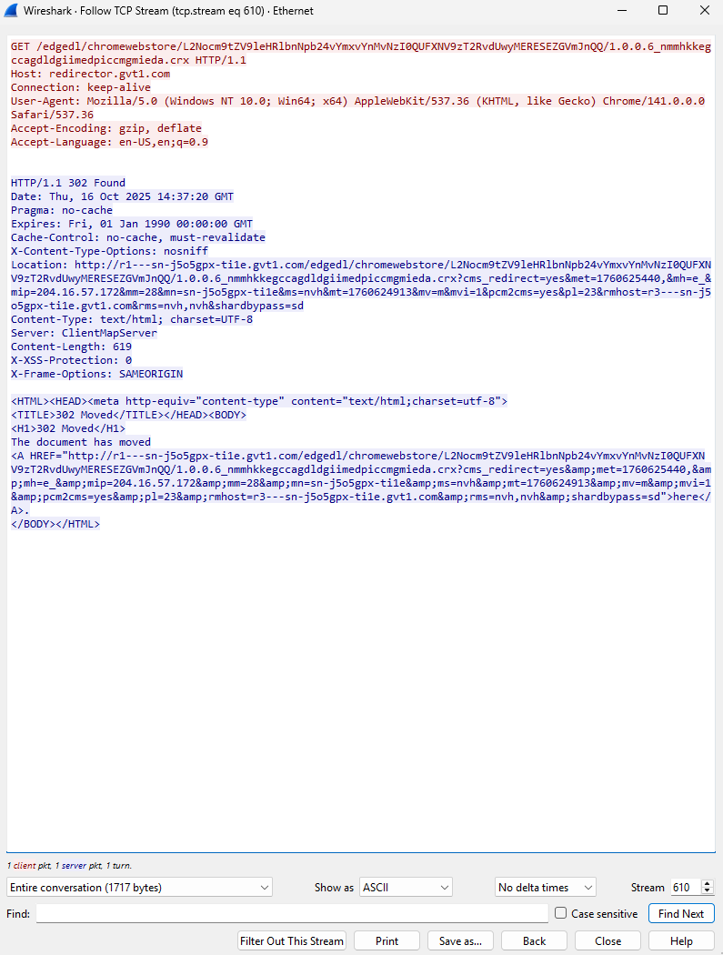
Screenshot 1 raw HTML of the website

Slide 3
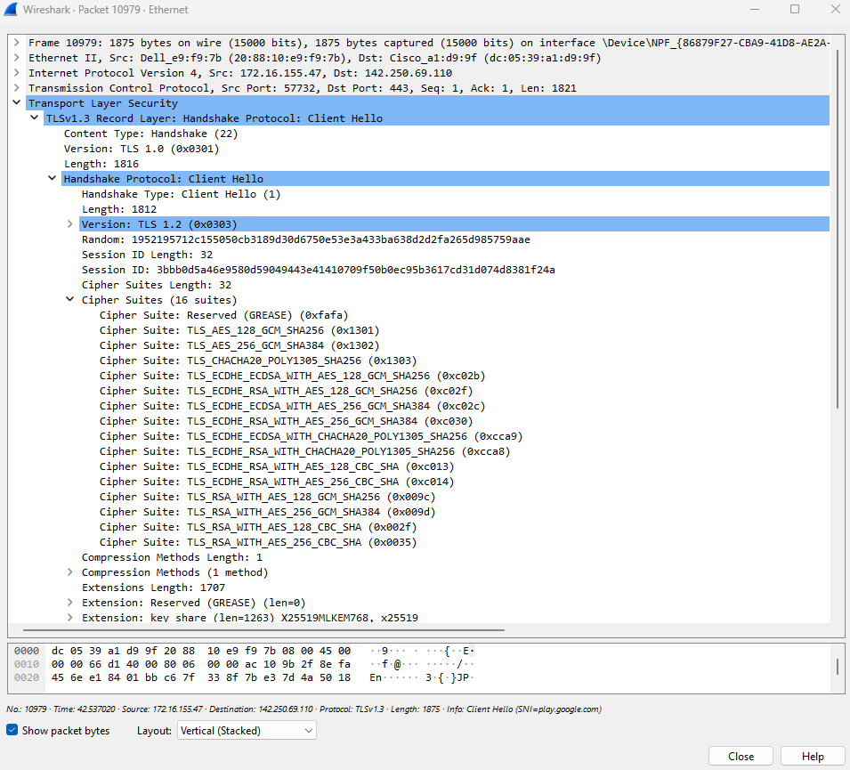
Screenshot 2 Cipher Suites list from the Client Hello message.

Slide 4
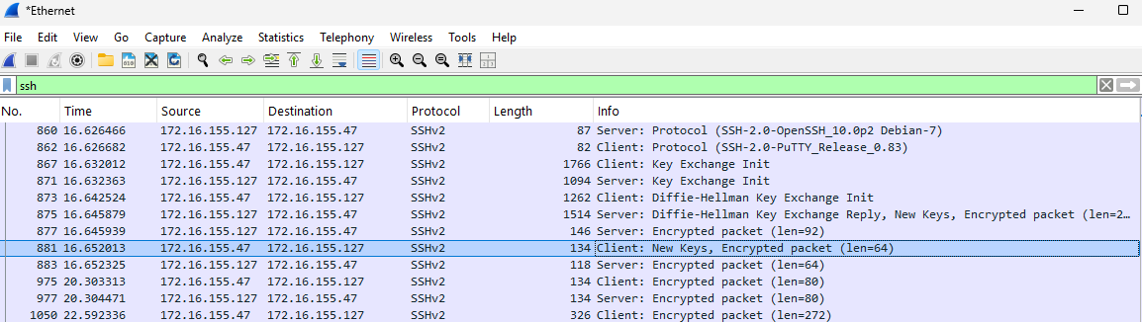
Screenshot 3 SSH Capture

Slide 5
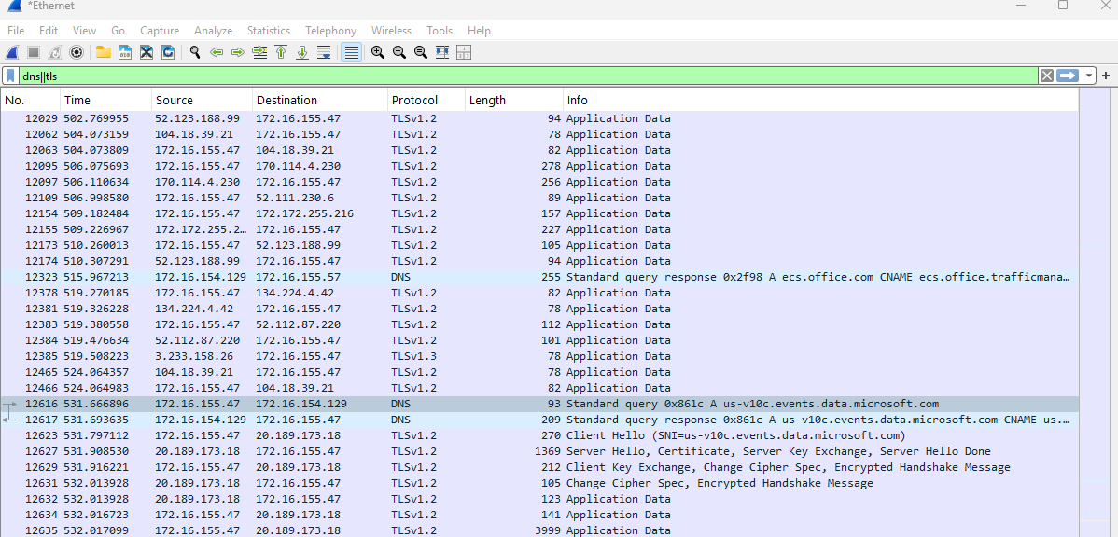
Screenshot 4 your analysis of what can be seen from https (dns vs https)
Can you use a combination of DNS and other HTTPS variables to figure out the domain, subdomain or full URL at all? Do lots of investigation. Key: this is for HTTPS not HTTP.
Using the display filter in wireshark, to display all DNS packets and all TLS packets (includes HTTPS handshakes and encryped records) use the dns||tls

